Slide 1

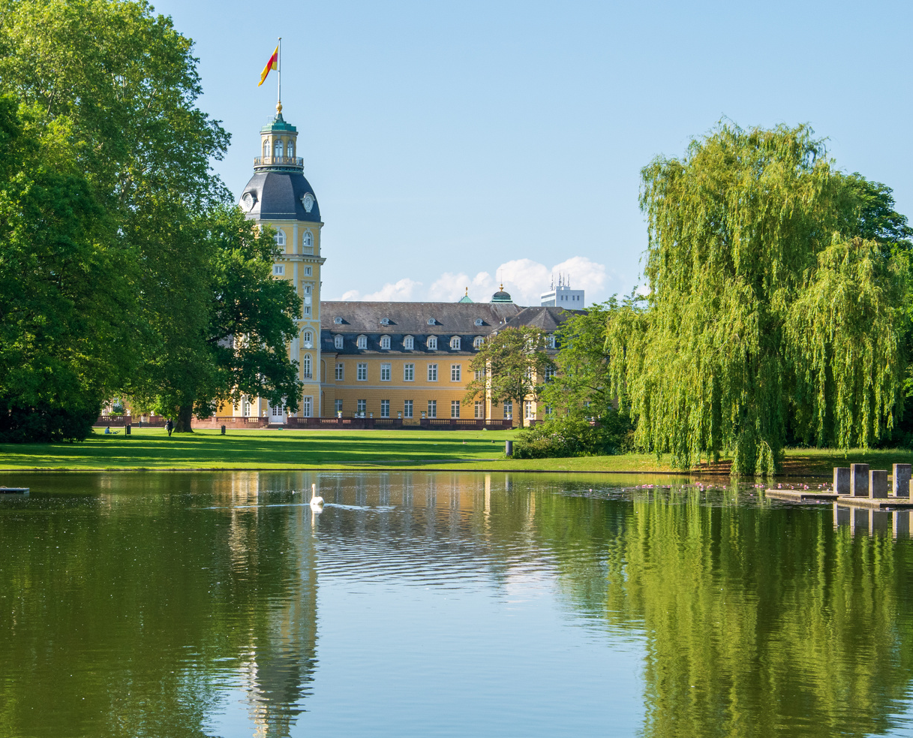
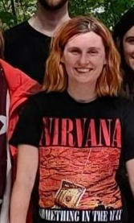
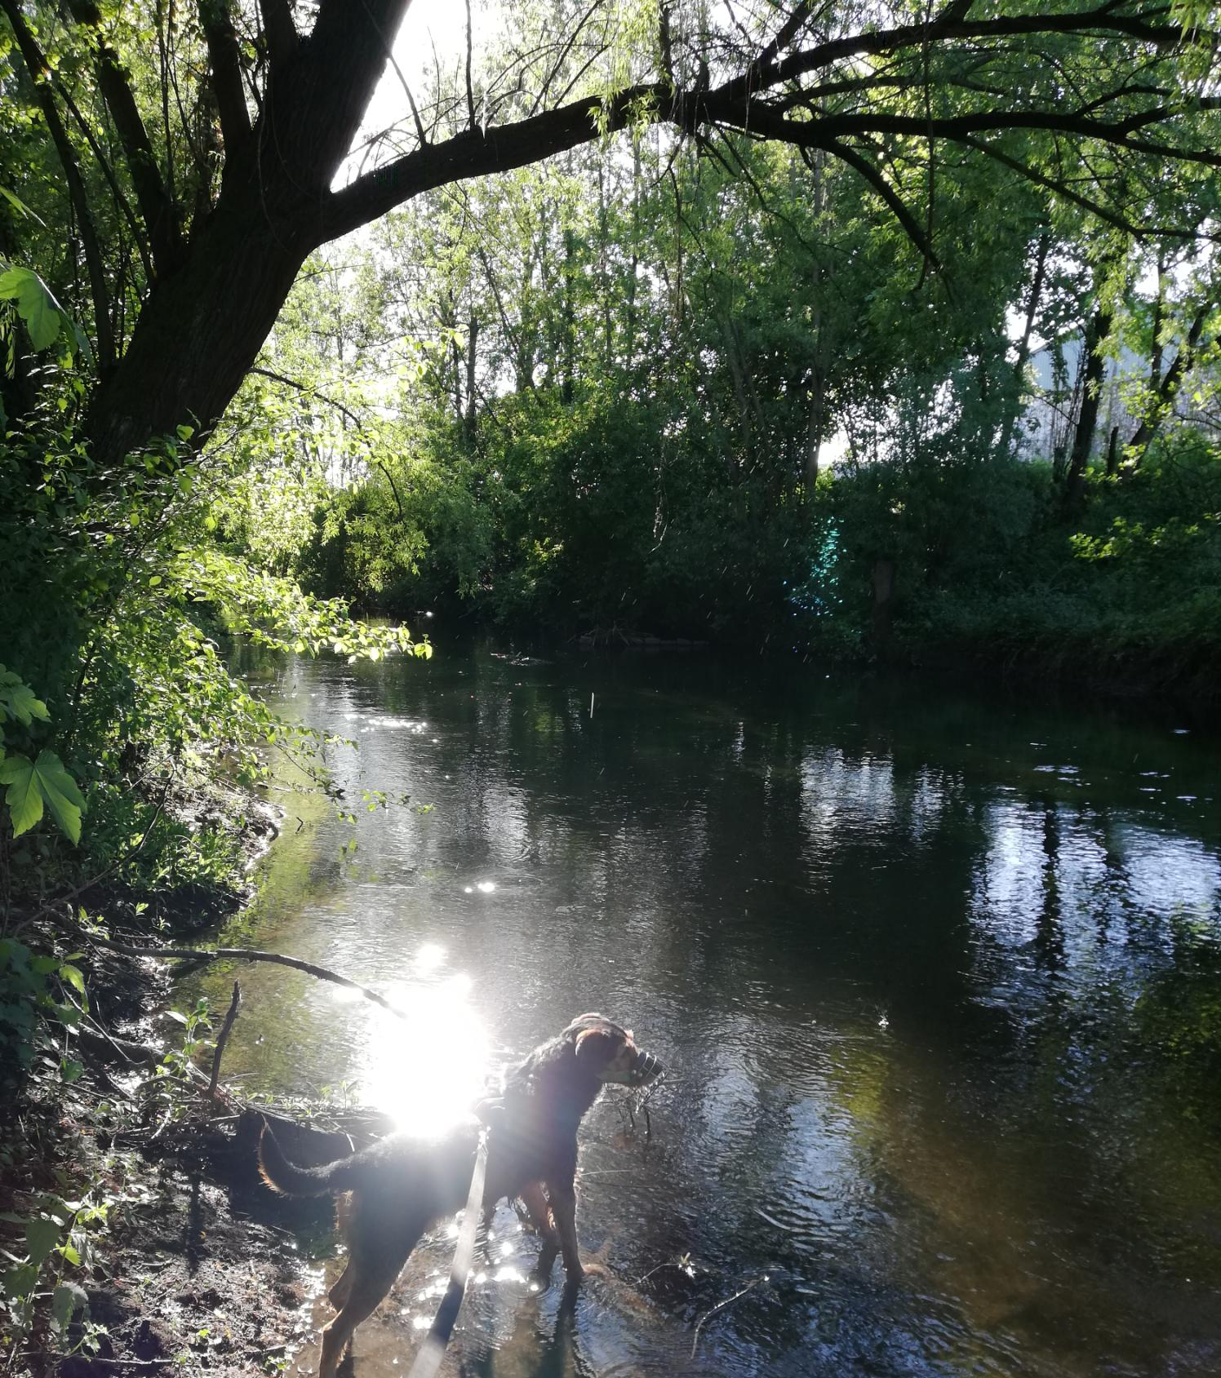



Robin Steil
University: University of Applied Sciences Karlsruhe (HKA)
Study program: Data Science Bachelor
Year of study: 5th semester
City: Karlsruhe, Germany
Motto for life: ”Baut auf, was euch aufbaut” ~ Build what builds you up.
Hobbies: studying Ethics / Philosophy, my dog, working in NGOs (climate education, climate justice, student sustainability group)
Your expectations from the summer school:
International perspectives on sustainability
Karlsruhe -
where I live & study
Karlsruhe
31 August to 11 September 2026

